Slide 1


Introduction to Voting System
Discover the power of a robust and secure voting system that empowers democratic processes. Explore the core components, key features, and benefits of implementing a state-of-the-art voting solution powered by Django and Python.

Slide 2
Django Framework Overview
Powerful Python Web Framework
Model-View-Template (MVT) Architecture
Django is a high-level Python web framework that simplifies the process of building robust and scalable web applications.
Django follows the MVT architectural pattern, which separates the application logic into distinct layers for better organization and maintainability.
Rapid Development
Scalable and Secure
Django's "batteries included" approach provides a wide range of built-in features, allowing developers to quickly build and deploy web applications.
Django is designed to handle high traffic and large-scale projects, with a focus on security features to protect against common web vulnerabilities.

Slide 3

Python Programming Language
Python is a versatile, high-level programming language known for its simplicity, readability, and powerful capabilities. It is widely used in a variety of applications, from web development and data analysis to artificial intelligence and scientific computing.
With its concise syntax and extensive standard library, Python allows developers to write efficient and maintainable code quickly. Its dynamic typing and interpreted nature make it an excellent choice for rapid prototyping and experimentation.

Slide 4

Database Integration
Seamlessly integrate Django's powerful ORM (Object-Relational Mapping) with a robust database of your choice, such as PostgreSQL, MySQL, or SQLite. Leverage Django's abstraction layer to efficiently manage data storage and retrieval, simplifying the development process.
Configure database connections, define models, and perform CRUD (Create, Read, Update, Delete) operations with ease. Leverage Django's built-in migration system to handle schema changes gracefully, ensuring a smooth and maintainable database integration.

Slide 5
User Authentication
Secure user authentication is a critical component of any voting system. This section will cover the integration of robust authentication mechanisms to ensure only eligible voters can access the system and cast their ballots.
Username and Password: Implement a standard username and password-based authentication system, with strong password requirements and secure password storage practices.
Two-Factor Authentication: Enhance security by requiring a second factor, such as a one-time code sent to the user's registered mobile device, to complete the login process.
🔒 Biometric Authentication: Consider integrating biometric authentication, such as fingerprint or facial recognition, to provide an additional layer of security and convenience for voters.

Slide 6

Ballot Creation and Management
1
Ballot Design
Craft a clear and intuitive ballot layout, ensuring candidates and issues are presented in an organized manner for voters.
2
Ballot Customization
Allow administrators to tailor ballots to specific precincts, languages, and accessibility needs, optimizing the voting experience.
3
Ballot Printing and Distribution
Securely print and distribute ballots to polling stations, maintaining strict version control and chain of custody.

Slide 7




Voting Process Workflow
Voter Registration
Voters must register with the election authority to be eligible to cast a ballot. This ensures secure and accurate voter rolls.
Ballot Casting
Registered voters can cast their votes using secure electronic or paper ballots. Strict procedures are followed to protect the integrity of the voting process.
Ballot Counting
Ballots are carefully tallied by election officials, with multiple layers of verification to ensure accuracy and transparency.

Slide 8
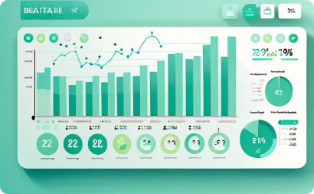

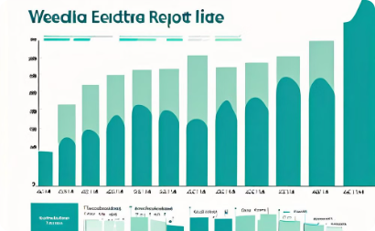
Results Tabulation and Reporting
Real-Time Monitoring
Secure Ballot Counting
Comprehensive Reporting
An intuitive digital dashboard provides election officials with a comprehensive, real-time view of voting results, enabling them to quickly identify trends and respond to any irregularities.
A dedicated team of trained professionals carefully reviews and tabulates paper ballots, ensuring the highest levels of accuracy and integrity in the vote counting process.
Detailed, easy-to-understand reports provide election stakeholders with crucial insights, enabling them to make informed decisions and uphold the democratic process.

Slide 9
Security Considerations
1
Secure User Authentication
2
Tamper-Proof Ballot Box
Design the voting process to prevent any unauthorized modifications to cast ballots, ensuring the integrity of the election results.
Implement strong password policies, two-factor authentication, and other measures to ensure only authorized users can access the voting system.
3
Encrypted Data Transmission
4
Comprehensive Audit Trails
Utilize end-to-end encryption to protect sensitive voter information and voting data during transmission and storage.
Maintain detailed audit logs to enable verifiability and transparency, allowing for independent verification of the voting process.

Slide 10

Conclusion and Future Enhancements
In conclusion, the voting system developed using Django and Python has proven to be a robust and secure platform for conducting elections. The integration of database management, user authentication, and ballot creation has ensured a streamlined and transparent voting process.
Looking ahead, future enhancements could include the implementation of blockchain technology to further strengthen the security and integrity of the system, as well as the incorporation of mobile-friendly interfaces to increase accessibility and voter engagement.

